Slide 2




The future of barcoding:
GS1 Digital Link
Stacey ejim, Marketing manager
BarTender Software
Elizabeth Sinclair, director of marketing, bartender software
Peter Hernandez, Enterprise Sales engineer,
Bartender software

Slide 3
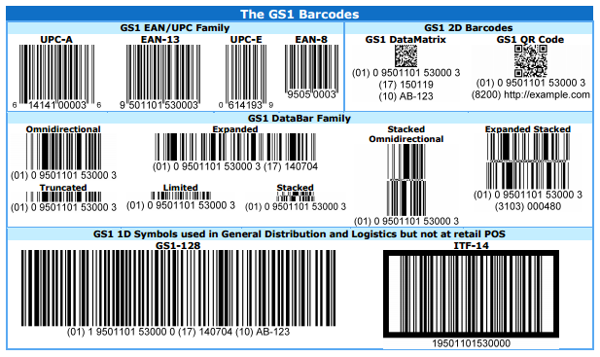
What is GS1?

Slide 4
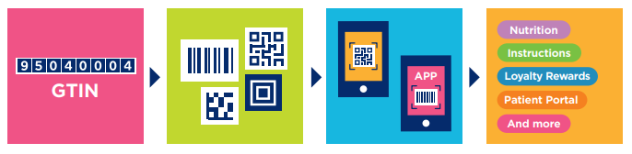
What is GS1 Digital Link?
A solution that “web-enables” barcodes
A barcode that contains a URL
Follows similar standards as the existing GS1 barcodes

Slide 5
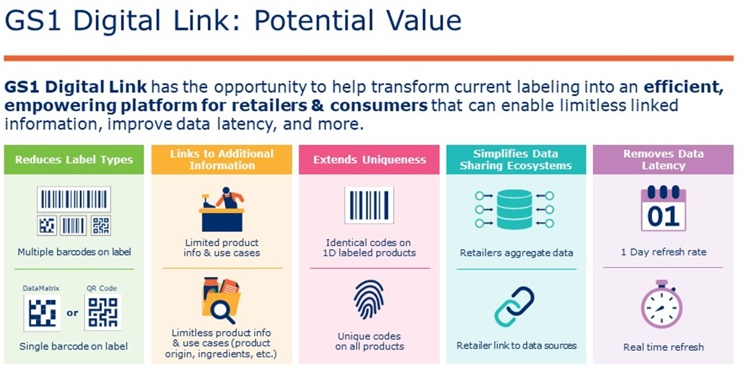
*Property of GS1

Slide 6

Why now?
Smart phones are everywhere
Consumers: the “Thin Interface”
New ways of thinking about labeling

Slide 7

Brands and Digital Link
Social media? It’s The Wild West.
Be the source of truth
Build trust
Influence pre-purchase decision
Corporate social responsibility
Encourage repeat purchases
Give consumers what they want

Slide 8

The Digital Link-enabled supply chain
Communicate safety and handling data
Enable the Circular Economy
Capture chain of custody
Traceability
Product, pricing and marketing information
Communicate safety and handling data

